Slide 1

Stroke Risk Prediction and Prevention in Hypertensive Patients aged 50-85 Years
Presented By:
Rashmitha Eri
Oscar Odera
December 3rd, 2024
Notes:
Welcome to our presentation on an innovative approach to stroke risk prediction and prevention. This project, led by Rashmitha Eri and Oscar Odera, aims to revolutionize how we assess and mitigate stroke risk in hypertensive patients aged 50-85 years. Our work combines cutting-edge machine learning techniques with clinical expertise to develop a powerful Clinical Decision Support System (CDSS).

Slide 2

The Overview of Stroke
Global Health Crisis
Obstructed Blood Flow
Stroke remains a leading cause of disability and mortality worldwide, with a particularly high impact on hypertensive populations.
Stroke occurs when blood flow to the brain is blocked, leading to severe health consequences and long-term disabilities.
Personalized Prevention
Our project aims to develop a CDSS using machine learning to provide tailored, preventive insights for at-risk individuals.

Slide 3


Justification of Population Selected
High Cardiovascular Risk
Age as a Critical Factor
Optimal CDSS Application
Hypertension is a significant modifiable risk factor for stroke. Effective blood pressure management can substantially reduce stroke incidence in this population.
Stroke risk doubles with each decade after 55 due to factors like arterial stiffness and plaque accumulation. This age group is particularly vulnerable and benefits most from targeted interventions.
Focusing on this demographic allows for timely interventions through lifestyle modifications and regular blood pressure monitoring, significantly reducing stroke risk.

Slide 4

Literature Review
Traditional vs. ML-Based Approaches
Conventional risk assessments rely on static metrics, often missing individual nuances.
ML provides a dynamic, personalized approach, adapting to specific health data.
Key Peer-Reviewed Studies
Yang et al. (2021): Logistic regression and decision trees achieved up to 89% accuracy in stroke prediction using health metrics (age, BP, glucose).
Sahoo et al. (2020): Random Forest outperformed Naive Bayes and KNN for cardiovascular risk.
Bhargav et al. (2022): Neural networks reached 96% accuracy, especially effective with large datasets.
Alalawi et al. (2021): Emphasized importance of feature selection, balanced data, and preprocessing for optimal model performance.

Slide 5



Dataset Overview
Source: Kaggle dataset with 5,110 patient records, providing a comprehensive base for our analysis.
Link: https://www.kaggle.com/datasets/fedesoriano/stroke-prediction-dataset
Original Features
Demographics (ID, Gender, Age, Residence Type), Health Metrics (Hypertension, Heart Disease, Avg Glucose Level, BMI), Lifestyle (Smoking Status, Marital Status, Work Type), and Stroke (target variable).
Selected Features
Age, Hypertension, Heart Disease: Known contributors to stroke risk.
Average Glucose Level, BMI: Indicators of metabolic health impacting cardiovascular risk.
Smoking Status: Assesses lifestyle impact on vascular health. These selected features are most predictive of stroke, enhancing model accuracy.

Slide 6
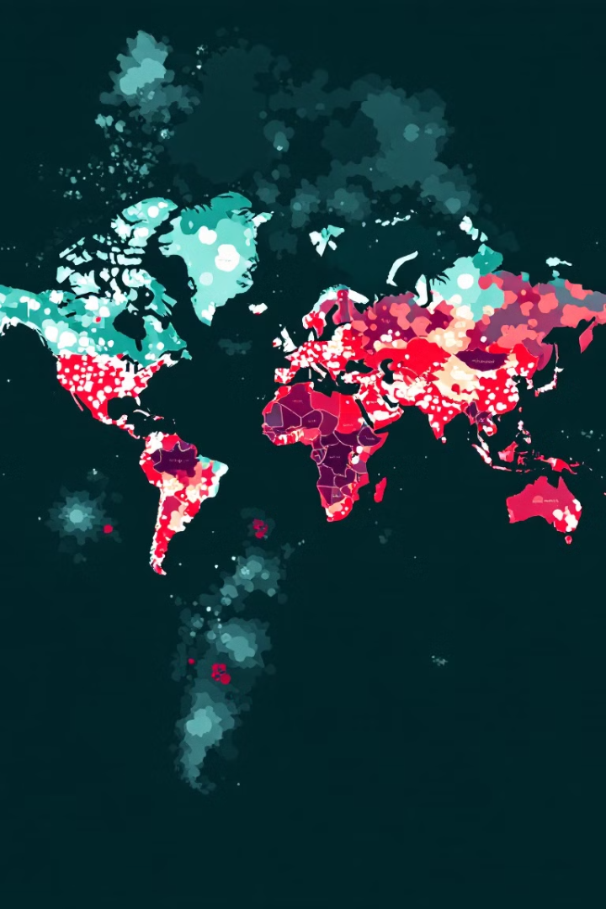
Frequency and Cost Data for Stroke
Statistics from WHO:
16.7M
Annual CVD Deaths
Cardiovascular diseases, including stroke, lead to approximately 16.7 million deaths worldwide each year.
5M
Stroke Fatalities
Stroke itself accounts for about 5 million deaths annually, with many survivors facing long-term disabilities.
4.87%
Dataset Incidence
In our dataset of 5,110 patients, 249 (4.87%) have experienced a stroke, reflecting the general population's stroke occurrence.

Slide 7




Hypertensive Patients and Stroke Risk
1
Among population in our dataset
498 Hypertensive Patients
2
Identified in the dataset
66 Stroke Cases
3
In hypertensive patients
4.87% Overall Rate
4
Stroke rate in the entire dataset
The significantly higher stroke rate among hypertensive patients (13.25% vs 4.87% overall) underscores the critical need for targeted prevention strategies.
High stroke rate among hypertensive patients indicates substantial healthcare expenses.
Targeted prevention for this group could lower costs by reducing the need for costly treatments and long-term care.

Slide 8
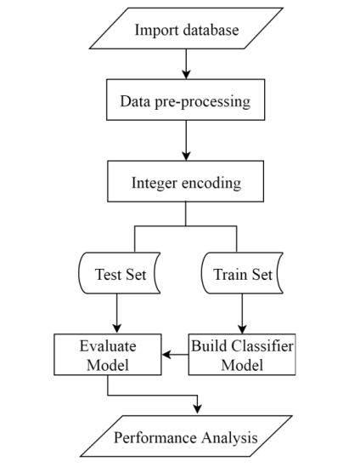
Measurement Approach and Model Selection
Model Selection:
Random Forest and XGBoost for their robustness and strong predictive power in structured health data.
Logistic Regression as an interpretable baseline
Neural Networks (MLP) for capturing complex, non-linear relationships.
This mix allows us to optimize both accuracy and clarity in stroke prediction, crucial in a medical context.
Secondary options: SVM and GaussianNB were considered.
Strengths and Weaknesses of Data:
Strengths: Dataset includes a broad spectrum of relevant health metrics that provide comprehensive input for predictive analysis.
Weaknesses: Dataset imbalance with fewer stroke cases, necessitating oversampling techniques like SMOTE to ensure balanced training and reliable model performance​.

Slide 9
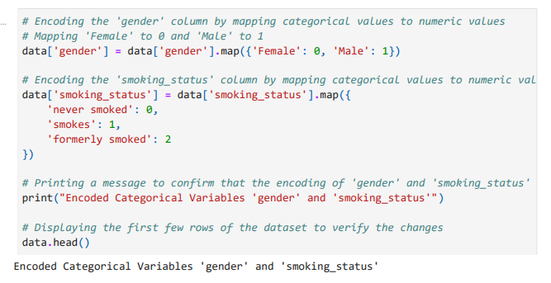
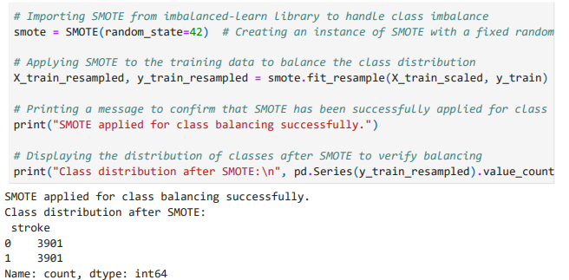
Addressing Risk Adjustment and Severity
Class Imbalance Solution
Implemented SMOTE (Synthetic Minority Over-sampling Technique) to address the minority of stroke cases, ensuring balanced training data and reliable model performance.
Categorical Variable Encoding
Encoded categorical variables such as gender and smoking status to standardize input data, enhancing the model's ability to handle diverse patient profiles and adjust for potential severity in cases.

Slide 10
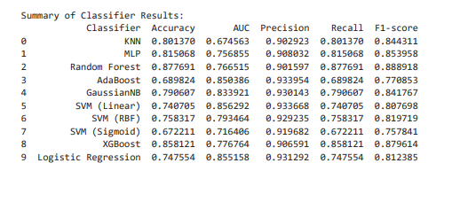
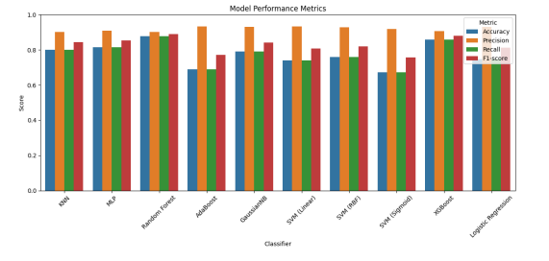
Models Performance

Slide 11

Key Findings and Conclusion
1
High-Risk Indicators
Age, hypertension, and high glucose levels strongly correlate with stroke risk, emphasizing the need for continuous monitoring.
2
Model Performance
Random Forest and XGBoost models demonstrated reliable prediction capabilities, with Random Forest outperforming in balancing accuracy and interpretability.
3
Potential Interventions
Our recommendations include lifestyle adjustments, regular screenings, and targeted medications for hypertension management.
4
Future Work
Further validation in clinical settings and integration with existing healthcare systems to maximize impact and improve patient outcomes.

Slide 12

Recommendations
Incorporating Additional Data Sources:
Socioeconomic and Lifestyle Data: Including data such as income, education, diet, and physical activity can enhance model predictions by providing context beyond just clinical measures.
Medical History: Integrating more detailed patient histories, such as comorbidities (diabetes, previous strokes), could improve prediction accuracy.
Feasibility:
Feasible if the relevant data can be sourced and integrated into the existing system. This might require access to patient records or third-party health data providers.

Slide 13
References
Accurately predicting stroke risk in hypertensive patients using applied machine learning on healthcare big data: Retrospective study. (2021, November 10). JMIR Medical Informatics. https://medinform.jmir.org/2021/11/e30277/
Prevention of stroke: Insights New evidence. (2009, December 1). OUP Academic.https://academic.oup.com/eurheartjsupp/article/11/suppl_F/F33/480006
AI Driven Stroke risk prediction from medical survey data: Explainable AI in risk analysis (XAI). (2023, November 20). medRxiv. https://www.medrxiv.org/content/10.1101/2023.11.17.23298646v2.
Interpretable machine learning for Mortality Prediction in hypertensive stroke patients in the ICU: A multi-center retrospective cohort study with internal and external cross-validation. (n.d.). Frontiers in Neurology https://www.frontiersin.org/journals/neurology/articles/10.3389/fneur.20
Stroke risk prediction with machine learning techniques. (2022, June 21). MDPI. https://www.mdpi.com/1688270

Slide 14


